Slide 1

CoPilot Safe Assist
Software Engineering 2: Project Teamwork Mälardalen University
Optimus Octavian

Slide 2

The north remembers… (briefly)

Slide 3
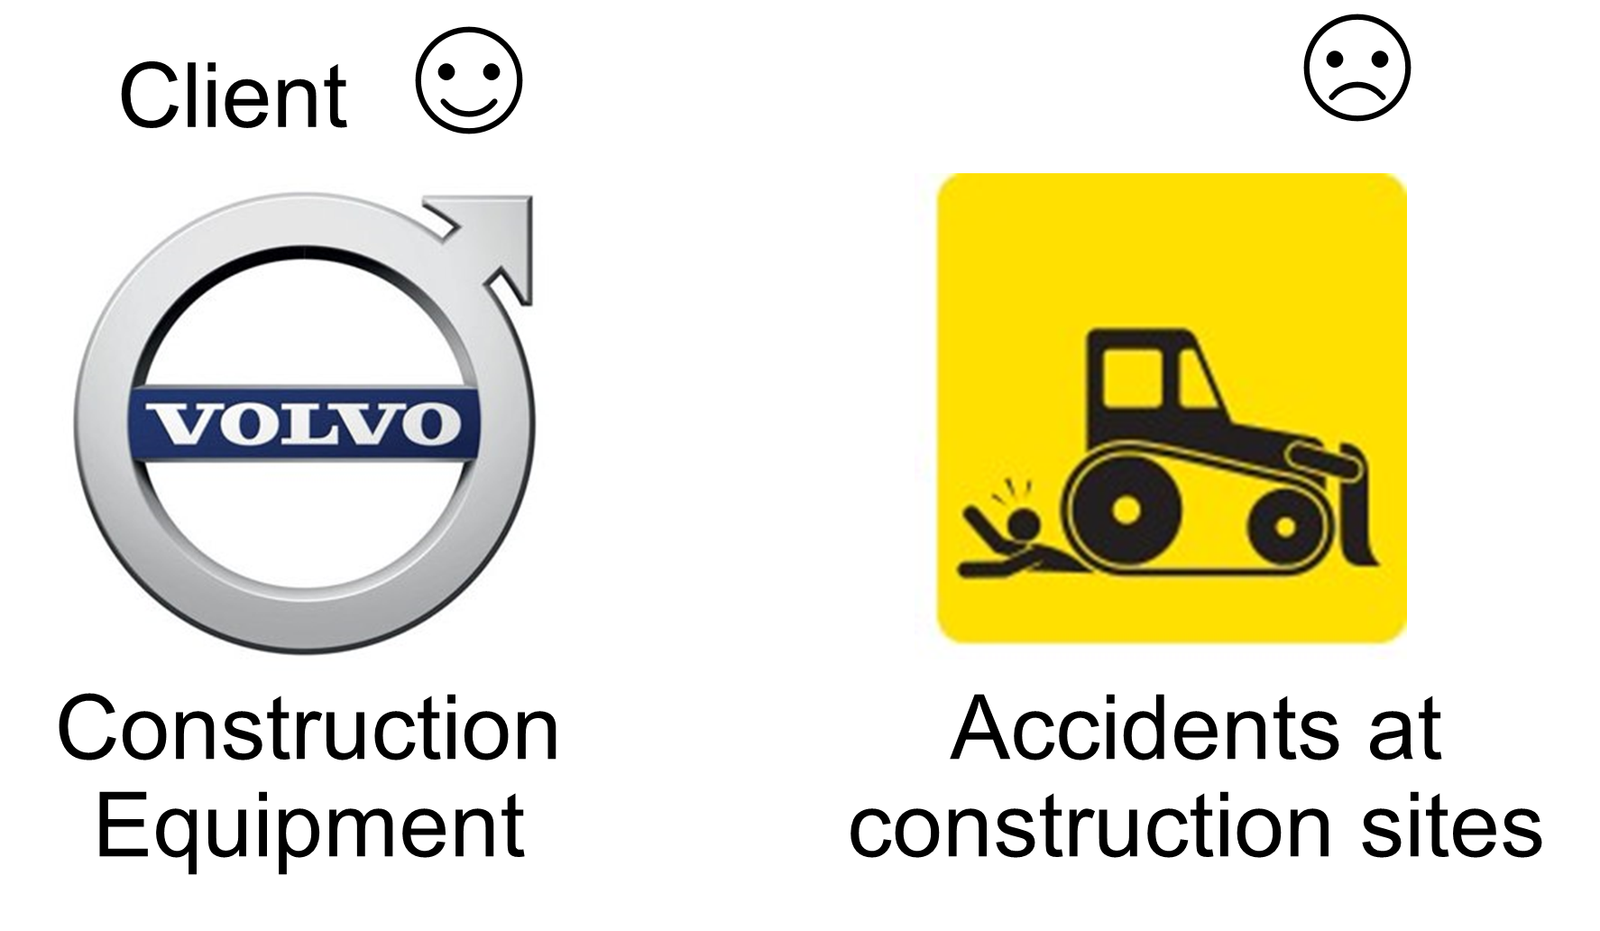
The north remembers… (briefly)

Slide 4
High-Level Architecture
Tiered-Client-Server
Server-Client with Model View Controller in the client
MVC with a connection to server
Notes:
- I know few people who like to design more than implement (maybe it's because I study Computer Science), but well, we have to do it.... So… We have been shuffling several architectures as you can see

Slide 5

High-Level Architecture
Tiered-Client-Server
Server-Client with Model View Controller in the client
MVC with a connection to server
Notes:
-In the tier client/server, most or all of the application logic and data is hosted on a server but we decide we needed an independent view to show the different data

Slide 6
High-Level Architecture
Tiered-Client-Server
Server-Client with Model View Controller in the client
MVC with a connection to server
Notes:
-It seemed to us that it was overlooked having a MVC inside the client

Slide 7
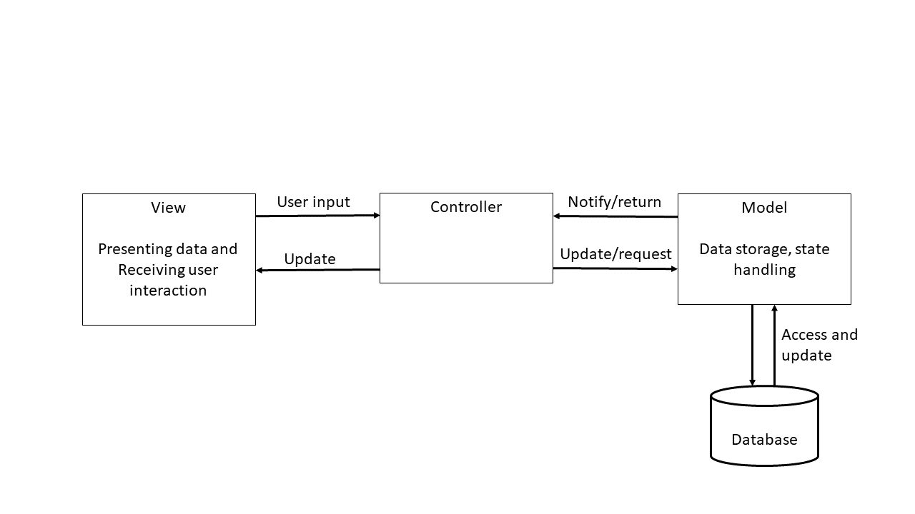
And the winner is…
-MVC with a connection to server
Notes:
-In order to centralize the operations in the server but keeping a client active, we proposed an MVC with a connection to server:
-View: User Interface
-Controller: Will process all the info provide by the client
-Model: Will store the current status and the data resulted in the operations

Slide 8
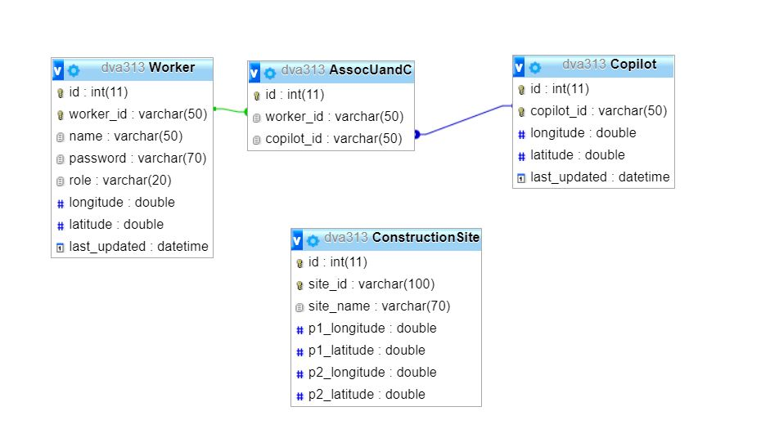
Being the DB like…
Notes:
-Here we can see the structure of the DataBase that will store some important information like:
-The association between the Worker and the Co-Pilot (that Will be an Operator Machine?)
-The Construction Site info where all will happens

Slide 9
What motivated the design?
The DB not be able to store data of the workers
Co-Pilot has API 15
The workers and operator must provide location
Notes:
- ”The DB not be able to store data of the workers”: We talk about personal data that could be stolen
“Co-Pilot has API 15”: Android 4.0.3 (Ice Cream Sandwich)
“The workers and operator must provide location”: To be able to calculate the location of the Units every moment (but only inside the construction site (safety feature))

Slide 10
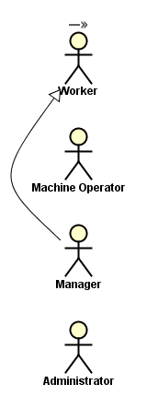
¿Who are the actors?
Will work in the Construction Site
Will work in a machine (with Co-Pilot)
Will manage all about the Construction Site (Inside the Construction Site)
Will manage the workers
(Outside the Construction Site)

Slide 11
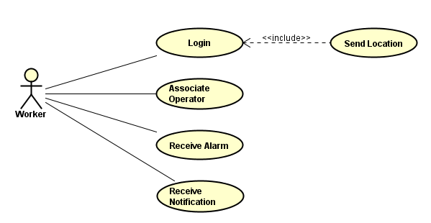
Worker
Notes:
If you log in, you send your location to the server automatically
Associate operator (to a machine)
Receive alarm (in a dangerous situation)
Receive notification (for notice the worker of things like: “Be careful!! You are in a Construction Site”)

Slide 12
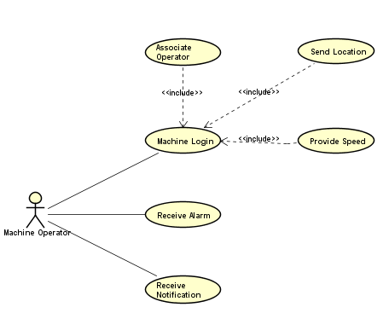
Operator Machine
Notes:
- If a machine operator logs in, its handleDevice must be associated to the Co-Pilot (because, if not, it will be receiving notifications and alarms all the time because in inside the vehicle so… is inside the vehicle dangerous range) and also, like the worker, it will send its location to the server automatically but, also its speed since speed is important in calculations
Receive alarm (in a dangerous situation)
Receive notification (for notice the worker of things like: “Be careful!! You are in a Construction Site”)

Slide 13
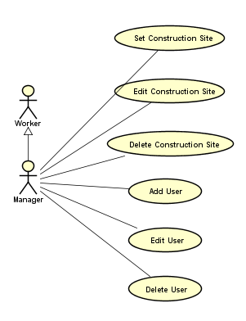
Manager
Notes:
Set, Edit and Delete the Construction Site where all will happens…
Add, Edit, Delete user: For temporally situations as a worker cannot work today because is sick or somthing like that, to do this in a long period there is…

Slide 14
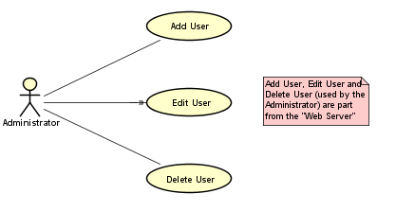
Administrator
Notes:
… that will do the same but not in the application as you will see after (NO SPOILERS). It will add, edit and delete users for a long period.
-This part belongs to the “Web Server” Side

Slide 15
Who is doing what?
-Handheld Device: Provide Location and listening to notifications and alarms
(Co-Pilot included)
-Server: Calculate locations and send notifications and alarms to handheld devices
Notes:
Handheld Device: That is the phone of the workers and the Co-Pilot integrated in the machines (listening all the time to notifications and alarms to ensure… that it will not die)
Server:

Slide 16
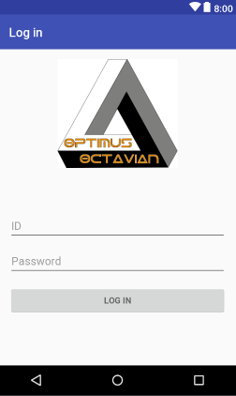
GUI

Slide 17
GUI
Notes:
Hablar de la decisión de colores y de fases de peligro

Slide 18
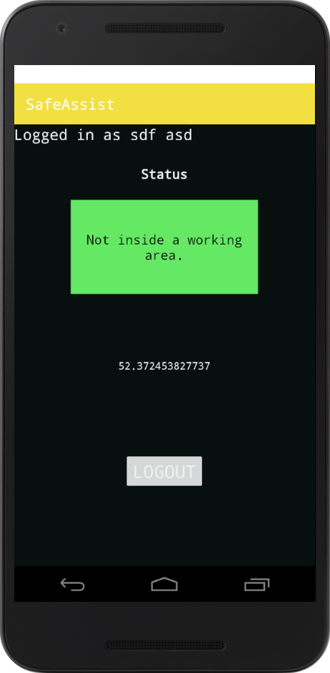
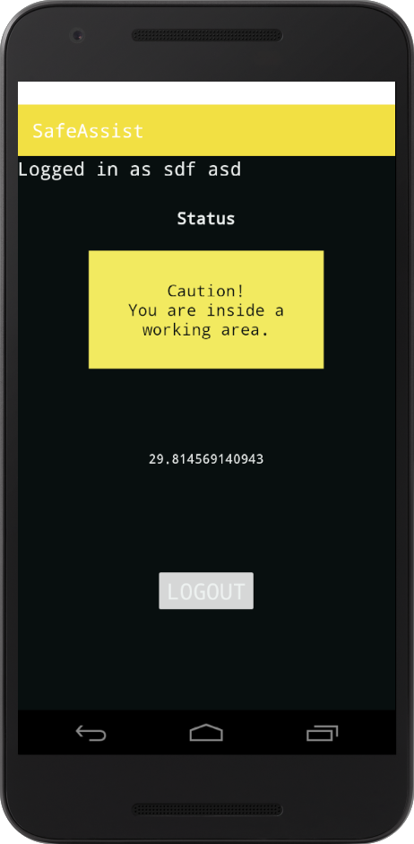
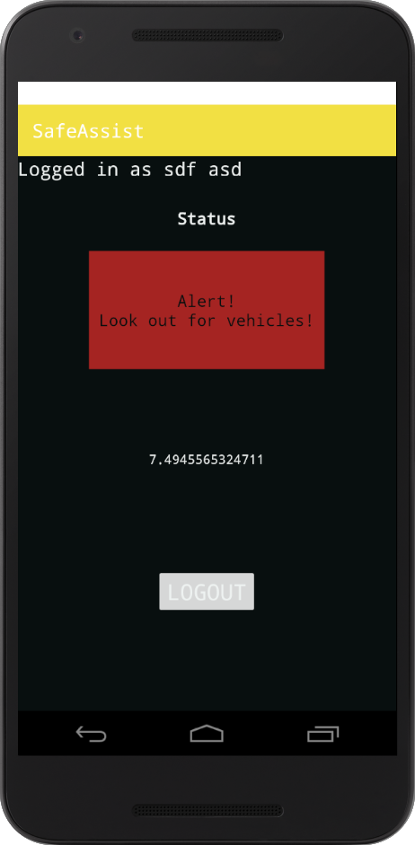
DEMO SCREENSHOTS

Slide 19

REMAINING TIME
We will implement
We will test

Slide 20
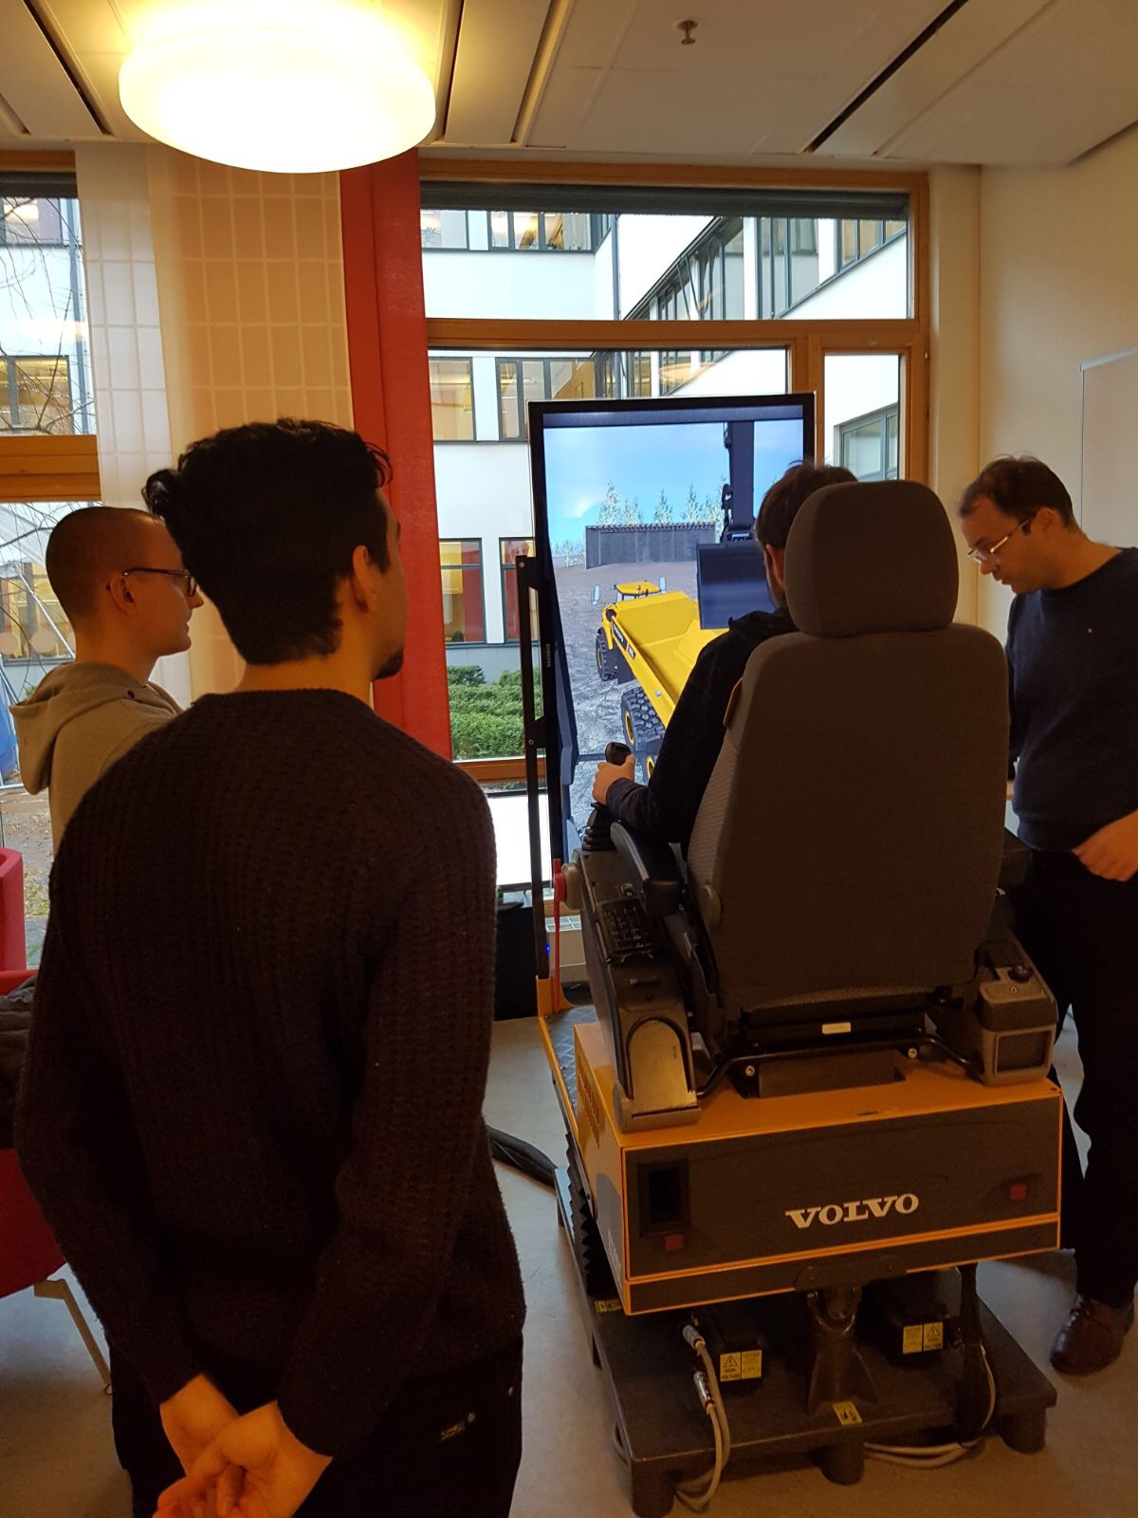
FOR TESTING
We are waiting for Adnan instructions.
We will have another meeting with the client on Skype.
We will have a meeting before christmas to revise the code

Slide 21
SOME IDEAS
Multiple construction areas.
A map from above.
Emergency button.
Mutable alarms.

Slide 22
